Slide 1
Pizza Sales Analysis using SQL
BY : SAURABH ARJUN KALE

Slide 2
Project Overview
The purpose of this project is to analyze pizza sales data to uncover valuable insights that can help improve business operations and strategy. By utilizing SQL queries, we aim to gain a deeper understanding of sales patterns, customer preferences, and revenue distribution. This analysis will aid in making data-driven decisions to enhance overall business performance.
The analysis covers various aspects such as the total number of orders, revenue generation, popular pizza types, order distributions, and revenue contributions by different pizza categories.

Slide 3
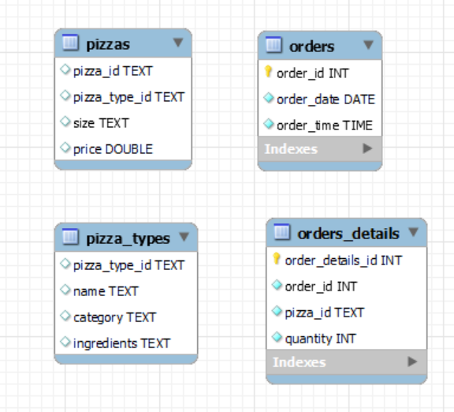
DATASET

Slide 4
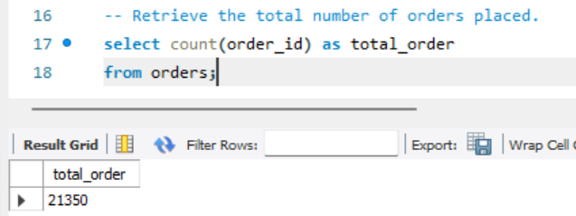
Retrieve the total number of orders placed.

Slide 5
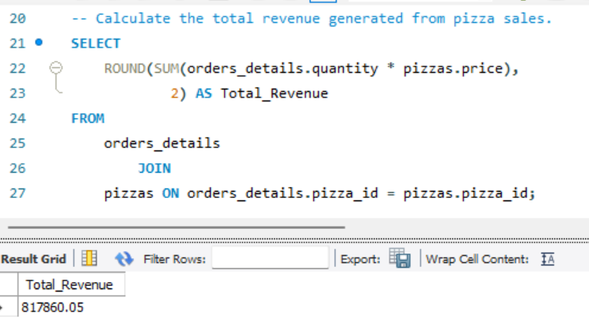
Calculate the total revenue generated from pizza sales.

Slide 6
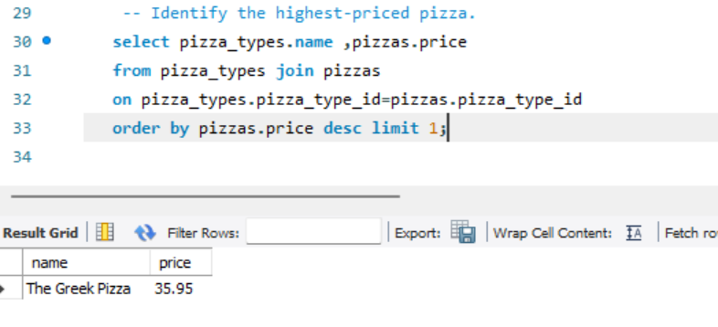
Identify the highest-priced pizza.

Slide 7
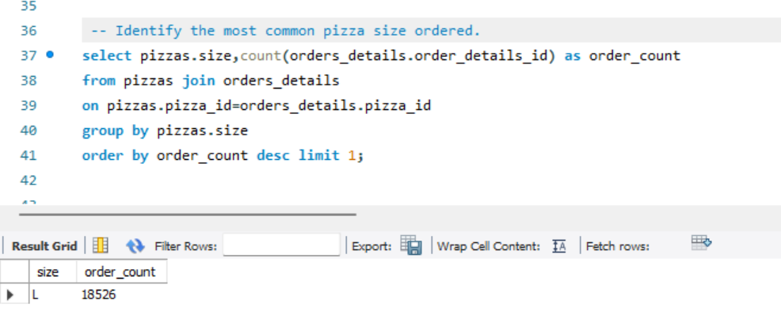
Identify the most common pizza size ordered.

Slide 8
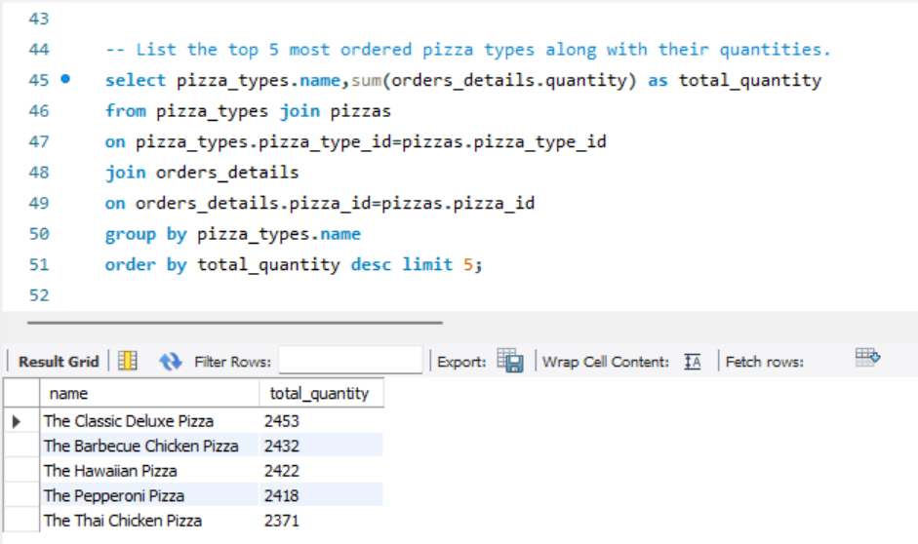
List the top 5 most ordered pizza types along with their quantities.

Slide 9
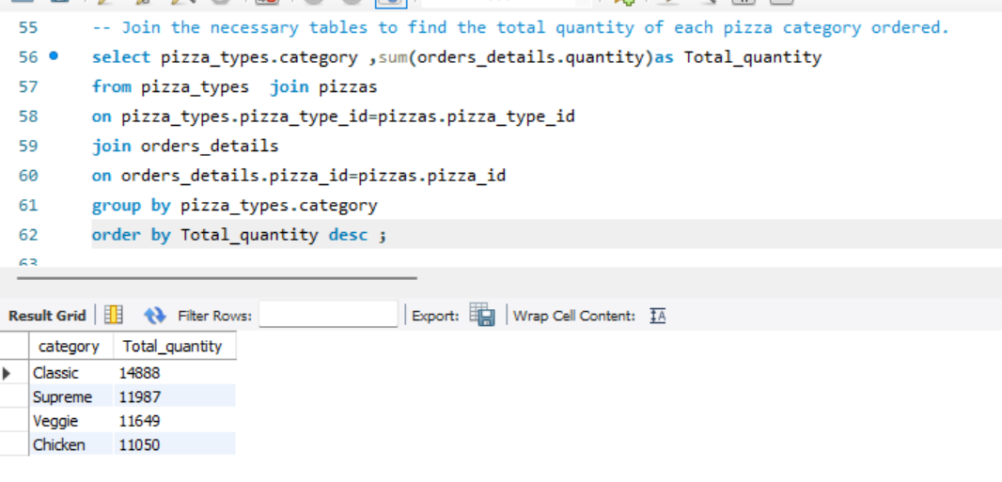
Join the necessary tables to find the total quantity of each pizza category ordered.

Slide 10
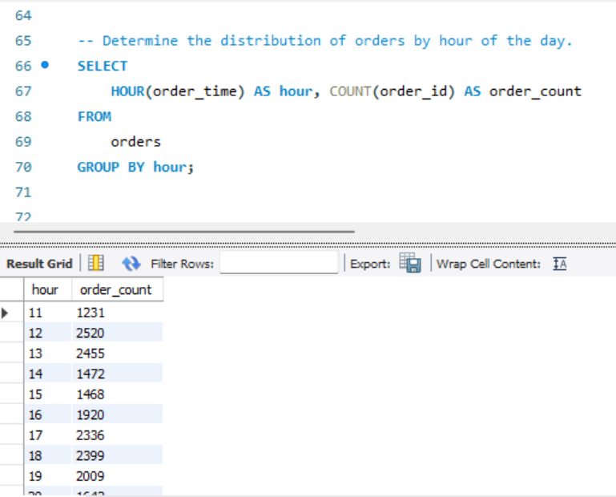
Determine the distribution of orders by hour of the day.

Slide 11
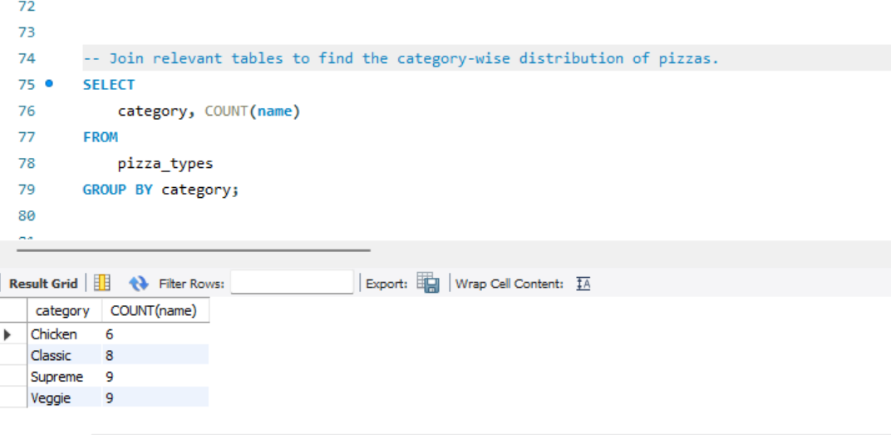
Join relevant tables to find the category-wise distribution of pizzas.

Slide 12
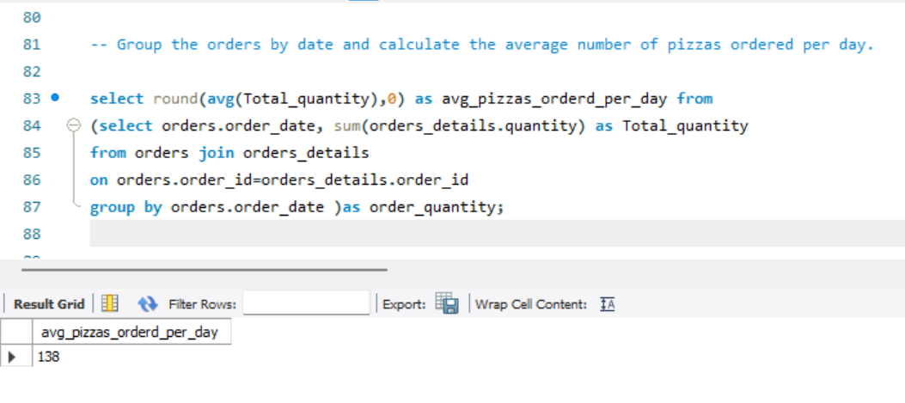
Group the orders by date and calculate the average number of pizzas ordered per day.

Slide 13
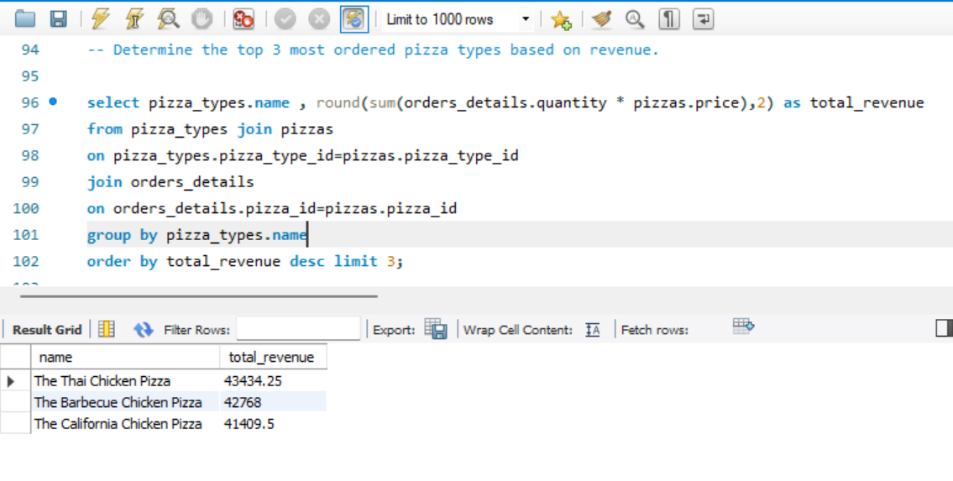
Determine the top 3 most ordered pizza types based on revenue.

Slide 14
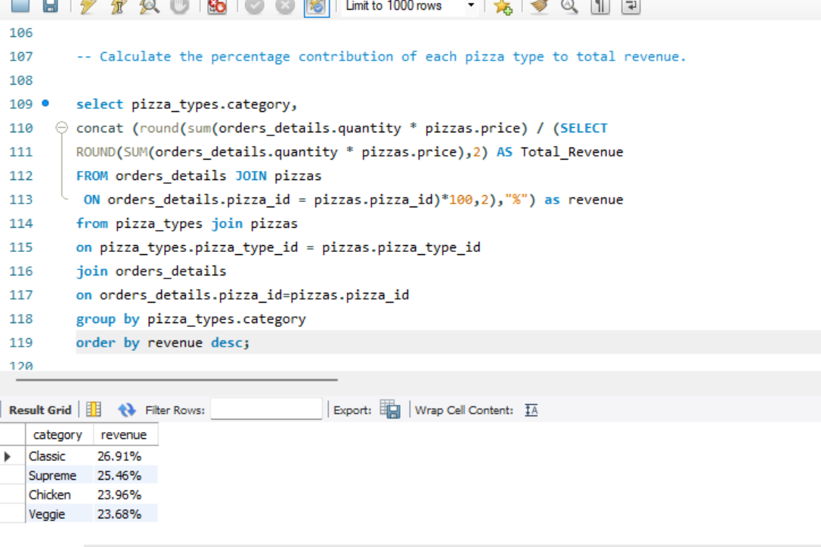
Calculate the percentage contribution of each pizza type to total revenue.

Slide 15
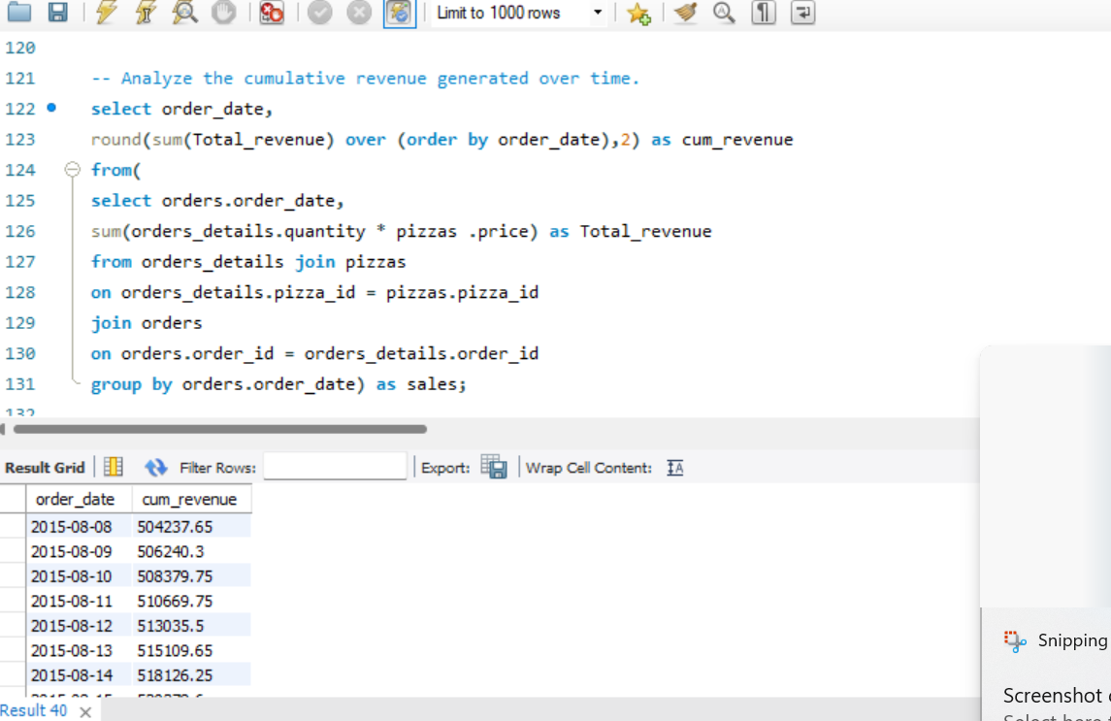
Analyze the cumulative revenue generated over time.

Slide 16
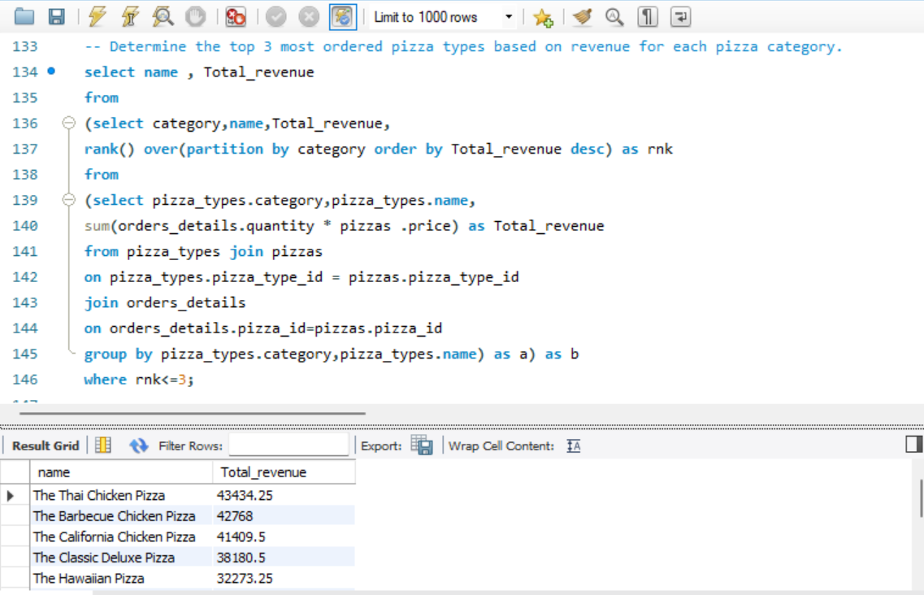
Determine the top 3 most ordered pizza types based on revenue for each pizza category.

Slide 17
THANK YOU

